Slide 1
Sons of God:
Imitating the firstborn Son
Eph 5:1-21, 1 Jn 2:3-6
09/07/17

Slide 2

Recap: Knowing the Father and make Him known (Acts 13:22)
And when He had removed him,
He raised up for them David as king,
to whom also He gave testimony and said,
‘I have found David the son of Jesse,
a man after My own heart,
who will do all My will.

Slide 3
Recap: Knowing the Father and make Him known
After knowing more and more about who our Father in heaven is, we begin to know more about ourselves as sons.
Everything we receive as a son:
- Salvation → Saviour
- Protection/Provision/Progress → Father
- Kingship (rule & reign with Him) → King
the purpose is to make the Father known
John 17:26 - I made known to them your name, and I will continue to make it known, that the love with which you have loved me may be in them, and I in them.

Slide 4


Imitating Christ (the firstborn Son)
Col 1:18 And He is the Head of the body, the church, who is the Beginning, the
First-born from the dead, that He may be pre-eminent in all things.
Psa 89:26-27 He shall cry to Me, My Father, You are my God, and the rock of my salvation. And I will make him My first-born, higher than the kings of the earth.

Slide 5
Imitating Christ
1 Cor 11:1 Be imitators of me, as I am of Christ.
Rom 8:28 And we know that all things work together for good to those who love God, to those who are the called according to His purpose. For whom He foreknew, He also predestined to be conformed to the image of His Son, that He might be the firstborn among many brethren.
Gal 4:19 My little children, for whom I labour in birth again until Christ is formed in you,
1 Pet 2:21 For to this you were called, because Christ also suffered for us, leaving us an example, that you should follow* His steps.

Slide 6
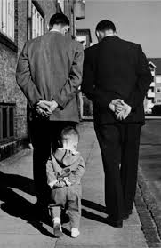
Walk as He walked
1 John 2:3-6 ³Now by this we know that we know Him, if we keep His commandments. ⁴He who says, “I know Him,” and does not keep His commandments, is a liar, and the truth is not in him. ⁵But whoever keeps His word, truly the love of God is perfected in him. By this we know that we are in Him. ⁶He who says he abides in Him ought himself also to walk just as He walked.
Eph 5:1-21 Therefore be imitators of God as dear children…

Slide 7
Walk as Jesus walk?
John 5:19 Then Jesus answered and said to them, “Most assuredly, I say to you, the Son can do nothing of Himself, but what He sees the Father do; for whatever He does, the Son also does in like manner.
Luk 3:22 And the Holy Spirit came down in a bodily shape, like a dove on Him. And a voice came from Heaven, which said, You are My Son, the Beloved; I am delighted in You.
14 For as many as are led by the Spirit of God, these are sons of God.

Slide 8
1) Walk in love (serve)
Eph 5:2 And walk in love, as Christ also has loved us and given Himself for us, an offering and a sacrifice to God for a sweet-smelling aroma.
Phil 2:5 Let this mind be in you which was also in Christ Jesus, 6 who, being in the form of God, did not consider it robbery to be equal with God, 7 but made Himself of no reputation, taking the form of a bondservant, and coming in the likeness of men. 8 And being found in appearance as a man, He humbled Himself and became obedient to the point of death, even the death of the cross.

Slide 9
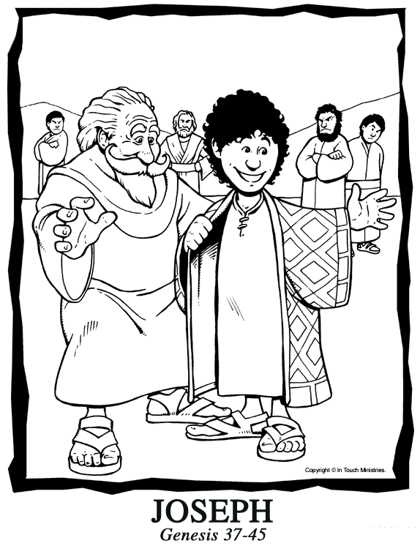
“Making of a prince” (Joseph)
Honour relationships in the house:
- With the father of the house
- With the brothers in the house

Slide 10

2) Walk in light
Eph 5:3-8,9 For you were once darkness, but now you are light in the Lord. Walk as children of light (for the fruit of the Spirit is in all
goodness, righteousness, and truth)
1 Jn 2:9 He who says he is in the light, and hates his brother, is in darkness until now. 10 He who loves his brother abides in the light, and there is no cause for stumbling in him. 11 But he who hates his brother is in darkness and walks in darkness, and does not know where he is going, because the darkness has blinded his eyes.
Walking in Jesus = the light for men to see

Slide 11
3) Walk in wisdom
Eph 5:15 See then that you walk circumspectly, not as fools but as wise, ¹⁶redeeming the time, because the days are evil. ¹⁷Therefore do not be unwise, but understand what the will of the Lord is.
HOW to be wise?
v18 Be filled with the Holy Spirit

Slide 12
Walking in the Spirit = wisdom
Acts 6:9-10 But some men from what was called the Synagogue of the Freedmen, including both Cyrenians and Alexandrians, and some from Cilicia and Asia, rose up and argued with Stephen. But they were unable to cope with the wisdom and the Spirit with which he was speaking.
1 Cor 2:12-14 Now we have received, not the spirit of the world, but the Spirit who is from God, so that we may know the things freely given to us by God, which things we also speak, not in words taught by human wisdom, but in those taught by the Spirit, combining spiritual thoughts with spiritual words. But a natural man does not accept the things of the Spirit of God, for they are foolishness to him; and he cannot understand them, because they are spiritually appraised.

Slide 13
Conclusion
Jesus walked
in (with) the Spirit
in love (sacrificing Himself),
in obedience (fulfilling all righteousness)
as the True light (giving light) and
increasing in wisdom and stature, and in favour with God and men (Luke 2:52).
Jesus the first-born Son set a pattern for us “adopted” sons of God to follow.
Jesus the King of kings and High Priest has made us kings and priests (Rev 1:6)

